Slide 1

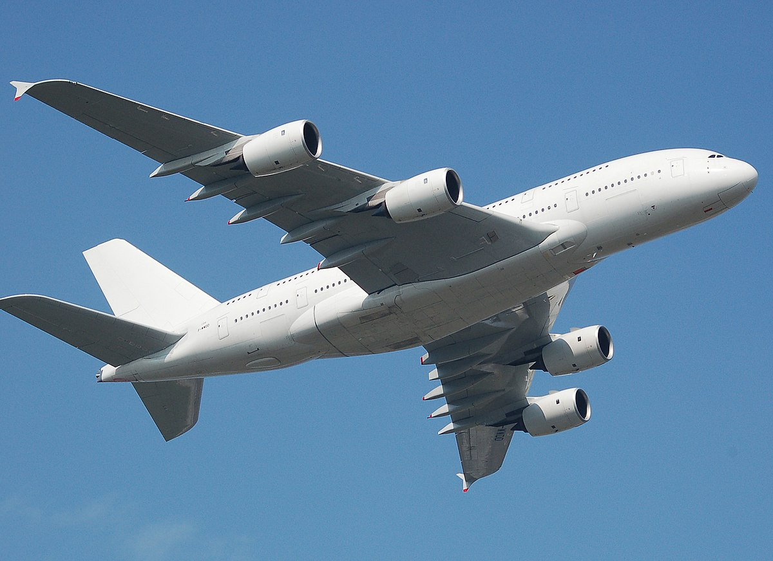

Travel & Accommodation
Data Analysis Project

Slide 2

Dataset Name:
Travel Dataset - Datathon 2019
Dataset
Dataset Link: https://www.kaggle.com/leomauro/argodatathon2019

Slide 3
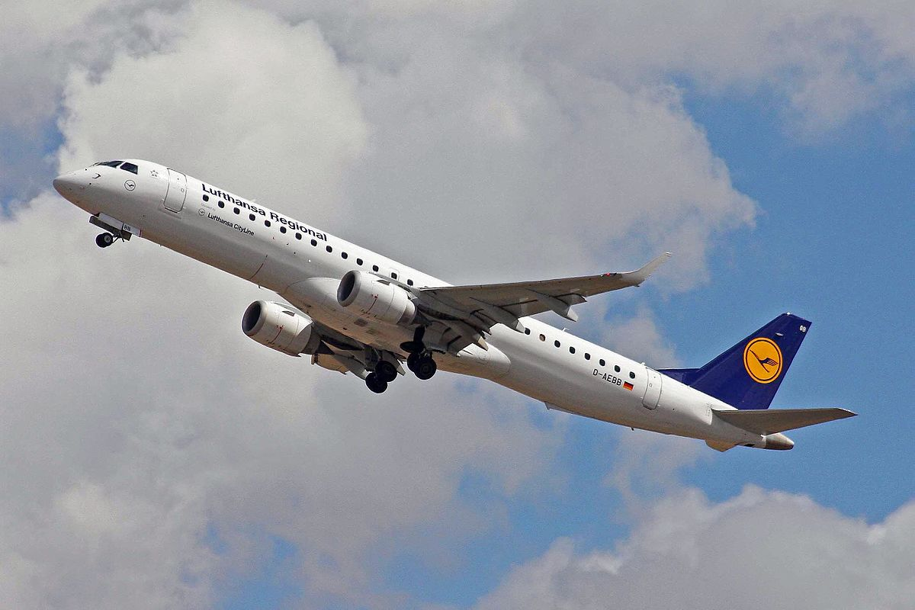
Here, provided a dataset simulating real corporate travel systems - focusing on flights and hotels. Analyze this set with over one thousand users and 250 thousand travels to produce insights.
List of Dataset: Flight.csv, Hotel.csv , User.csv
Data :
Travel Code , user Code , Flight Type , Agency , From , To , Flight Price, Hotel Name ,place ,Days ,Total Cost ,User Name ,Age ,Gender Company
Number of Rows and Column : 81104 rows × 20 columns

Slide 4
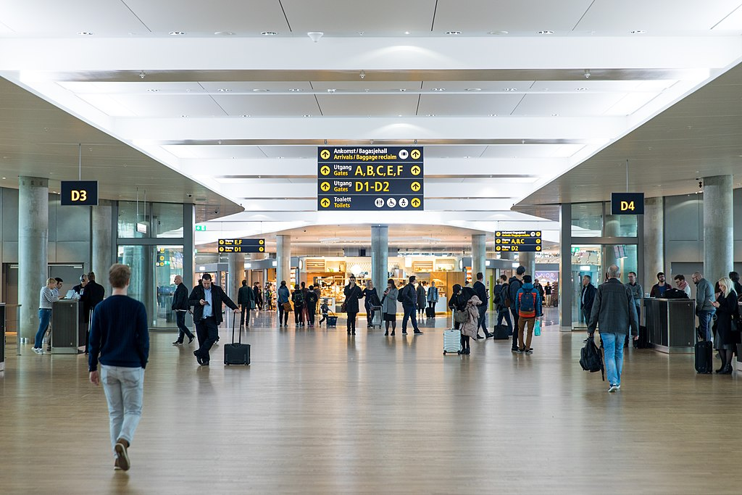
Cases Used for Analyses Data from Travel Dataset:
Most used flight type by Gender
Time & Distance of flights with flight name
Most use hotel name & price & User code
Most person travel from Particular company
Days of staying in hotels with Hotel Name & Total Price.
Age of persons who travelling in Particular Agency and their Destination
find hotels in flight destination

Slide 5

Plots used for Analyses Data from Travel Dataset:
Count plot
Bar Plot
Pivot Table
Box Plot
Line plot
Scatter plot

Slide 6

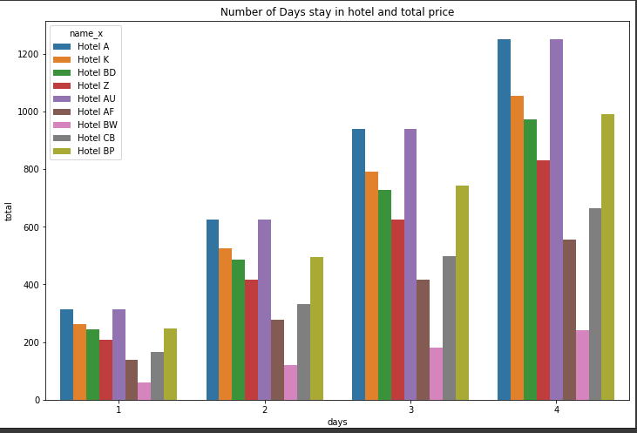
Days of staying in hotels with Hotel Name & Total Price.

Slide 7
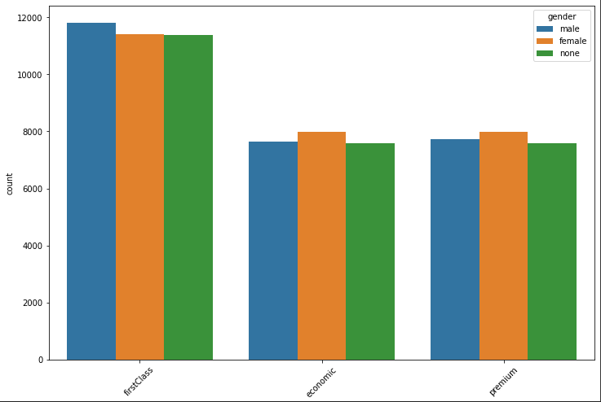
Most used flight type by Gender

Slide 8
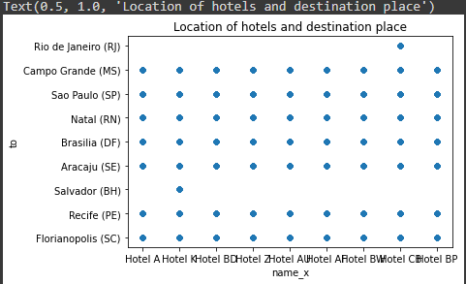
Find hotels in flight destination

Slide 9
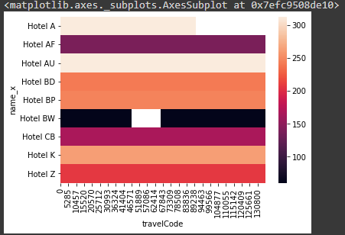
Most use hotel name & price & Travel code

Slide 10
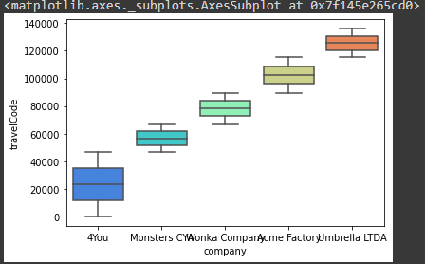
Most person travel from Particular company

Slide 11
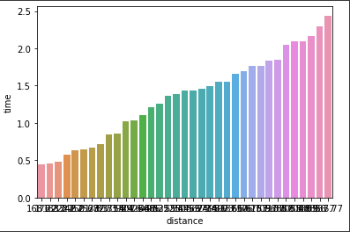
Time & Distance of flights

Slide 12
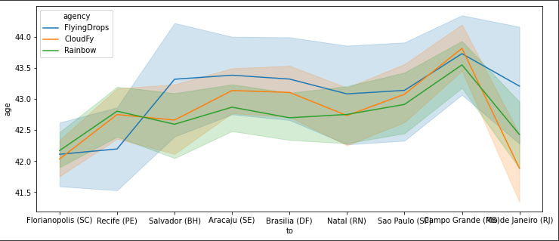
Age of persons who travelling in Particular Agency and their Destination

Slide 13


